Slide 1
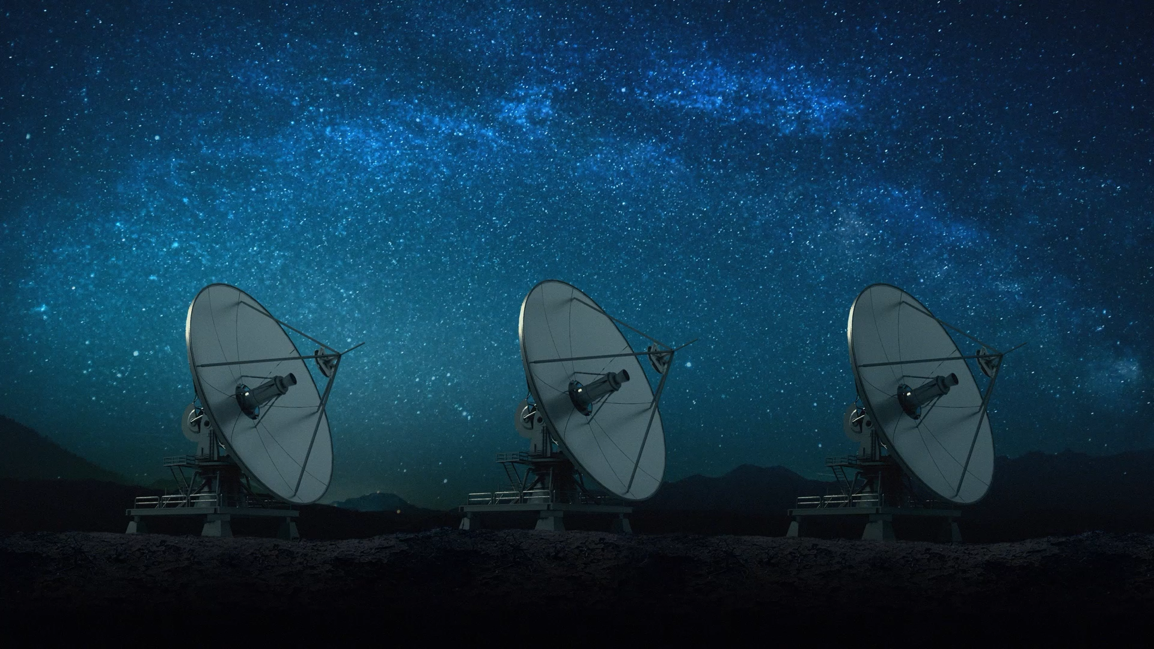
Critical Communications in Remote Areas using LEO Satellites
YICHEN CHEN
n11564628
Major Cyber security
Cluster 6
Tutor Anisur Rahman
Supervisor Muhammad Furqan

Slide 2
Introduction

Slide 3
Literature Review
Study Area | Key Points | Findings
Telemedicine – Cleft Lip and Palate in Manaus, Brazil | - Patients: 167 (30 with cleft lip, 51 with cleft palate, 14 with cleft lip/nasolabial deformity, 4 with hand deformities). - Telemedicine enabled surgical scheduling based on severity. | - 22 out of 30 cleft lip patients were infants (0-1 year). - The largest group of cleft palate patients was 2-4 years old. - 99 patients were scheduled for surgery via telemedicine, with 100% treatment rate.
Telemedicine – Stroke Care in NEVAS Network (Germany) | - Stroke cases treated from 2014–2019: Increased from 1,544 to 1,885. - Key focus: TIA/stroke treatment and risk factor management. | - Median patient age increased slightly (77 to 78 years). - NIHSS scores improved from 3 to 2. - Significant reductions in hypertension (75.2% to 66.4%) and diabetes (24.7% to 20.4%). - Shorter hospital stays (from 6 to 4-9 days).
Light pollution- Satellite Reflection on Astronomy | - Impact of satellite reflections on astronomical observations. - Study location: Cerro Pachón, Chile. - Simulations for satellites at 500 km and 1,200 km altitudes. | - In winter: 4 to 8 hours of illuminated satellites at night. - End of twilight: 63% (500 km) to 80% (1,200 km) of sky lit by 40-100 satellites. - Satellite light diminishes during shorter summer nights, but never completely disappears.

Slide 4
Objective of the research
Stable LEO satellite connections in remote areas
Importance of LEO satellites in remote areas
Environmental issues arise from LEO satellites

Slide 5
Methodology
Approach:
Comparative analysis of
peer-reviewed research papers
Scope:
Focus on three key points
1. Stable satellite connections
2. Improve living quality
3. Environmental pollution

Slide 6
Results
Parameter | 500 km Altitude | 1,200 km Altitude
Observer Location | Cerro Pachón, Chile (Rubin Observatory, LSST) | Cerro Pachón, Chile (Rubin Observatory, LSST)
Simulations Performed | Summer and Winter | Summer and Winter
Maximum Night Sky Illumination (Winter) | Up to 4 hours of illuminated satellites | Up to 8 hours of illuminated satellites
Number of Satellites Illuminated at Twilight | ~40 satellites | ~100 satellites
Sky Percentage Containing Illuminated Satellites (Winter, End of Twilight) | 63% | 80%
Sky Percentage Receiving Reflections (1 Hour Into Night) | 28% | 58%
Time Until Satellites No Longer Illuminated (Winter) | 2 hours after twilight | 4 hours after twilight
Summer Night Illumination | Illumination never completely ends | Illumination never completely ends
Number of Illuminated Satellites in Summer Night | Drops significantly but persists | Drops significantly but persists

Slide 7
Discussion
Parameter | 500 km Altitude | 1,200 km Altitude
Observer Location | Cerro Pachón, Chile (Rubin Observatory, LSST) | Cerro Pachón, Chile (Rubin Observatory, LSST)
Simulations Performed | Summer and Winter | Summer and Winter
Maximum Night Sky Illumination (Winter) | Up to 4 hours of illuminated satellites | Up to 8 hours of illuminated satellites
Number of Satellites Illuminated at Twilight | ~40 satellites | ~100 satellites
Sky Percentage Containing Illuminated Satellites (Winter, End of Twilight) | 63% | 80%
Sky Percentage Receiving Reflections (1 Hour Into Night) | 28% | 58%
Time Until Satellites No Longer Illuminated (Winter) | 2 hours after twilight | 4 hours after twilight
Summer Night Illumination | Illumination never completely ends | Illumination never completely ends
Number of Illuminated Satellites in Summer Night | Drops significantly but persists | Drops significantly but persists

Slide 8
Conclusion
Cross-Sector Integration
Environmental Impact of Satellite Constellations
Future work

Slide 9
Reference
Abdi, B., Mirtalaei, S. M. M., & Ghasemi, R. (2013). EMB Charger and MPPT Merging in Micro-Satellites. International Journal of Machine Learning and Computing, 318–321. https://doi.org/10.7763/ijmlc.2013.v3.330
Ahmmed, T., Alidadi, A., Zhang, Z., Chaudhry, A. U., & Yanikomeroglu, H. (2022). The Digital Divide in Canada and the Role of LEO Satellites in Bridging the Gap. IEEE Communications Magazine, 60(6), 24–30. https://doi.org/10.1109/mcom.001.2100795
Ali, A. J., Khalily, M., Sattarzadeh, A., Massoud, A., Hasna, M. O., Khattab, T., Yurduseven, O., & Tafazolli, R. (2021). Power Budgeting of LEO Satellites: An Electrical Power System Design for 5G Missions. IEEE Access, 9, 113258–113269. https://doi.org/10.1109/access.2021.3104098
Andreadis, A., Giambene, G., & Zambon, R. (2023b). Low-Power IoT for Monitoring Unconnected Remote Areas. Sensors, 23(9), 4481. https://doi.org/10.3390/s23094481
Jin, C., He, X., & Ding, X. (2019). Traffic Analysis of LEO Satellite Internet of Things. 2019 15th International Wireless Communications & Mobile Computing Conference (IWCMC). https://doi.org/10.1109/iwcmc.2019.8766604
Jin, L., Wang, L., Jin, X., Zhu, J., Duan, K., & Li, Z. (2022). Research on the Application of LEO Satellite in IOT. 2022 IEEE 2nd International Conference on Electronic Technology, Communication and Information (ICETCI). https://doi.org/10.1109/icetci55101.2022.9832117
Koller, J. S., Thompson, R. C., Riesbeck, L. H., & The Aerospace Corporation. (2020). SPACE AGENDA 2021: LIGHT POLLUTION FROM SATELLITES. In CENTER FOR SPACE POLICY AND STRATEGY. https://aerospace.org/sites/default/files/2020-10/Koller-Thompson_LightPollution_20201026.pdf

Slide 10
Masouris, I., Kellert, L., Pradhan, C., Wischmann, J., Schniepp, R., Müller, R., Fuhry, L., Hamann, G. F., Pfefferkorn, T., Rémi, J. M., & Schöberl, F. (2024). Telemedical stroke care significantly improves patient outcome in rural areas: Long-term analysis of the German NEVAS network. International Journal of Stroke. https://doi.org/10.1177/17474930241234259
McGrail, M. R., & Humphreys, J. S. (2009). Geographical classifications to guide rural health policy in Australia. Australia and New Zealand Health Policy, 6(1). https://doi.org/10.1186/1743-8462-6-28
Qiu, H., Yuting, C., Meng, Y., Fei, W., Yong, Y., Hongwei, Z., & Ni, L. (2023). Research on Reliability Improvement of Power Grid Based on 10kV Distribution Line Cross City Interconnection. 2023 5th International Conference on Electrical Engineering and Control Technologies (CEECT). https://doi.org/10.1109/ceect59667.2023.10420586
Su, Y., Liu, Y., Zhou, Y., Yuan, J., Cao, H., & Shi, J. (2019). Broadband LEO Satellite Communications: Architectures and Key Technologies. IEEE Wireless Communications, 26(2), 55–61. https://doi.org/10.1109/mwc.2019.1800299
Xia, D., Zheng, X., Duan, P., Wang, C., Liu, L., & Ma, H. (2019). Ground-Station Based Software-Defined LEO Satellite Networks. https://doi.org/10.1109/icpads47876.2019.00102
Yue, P., Du, J., Zhang, R., Ding, H., Wang, S., & An, J. (2023). Collaborative LEO Satellites for Secure and Green Internet of Remote Things. IEEE Internet of Things Journal, 10(11), 9283–9294. https://doi.org/10.1109/jiot.2022.3223913

